Slide 1
killer features of the obs MVP for the ideas lab, keeping in mind time and budget, and then killer features post ideas lab

Slide 2
Before
Book recommendations for the academy
Manually select top profiles
Simple ranking based on one variable

Slide 3
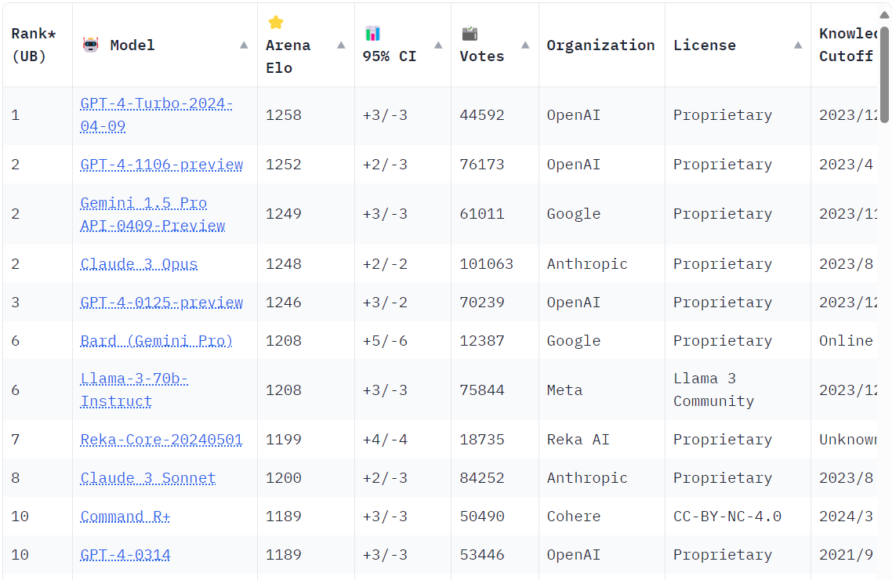
Notes:
Chatbot Arena

Slide 4
After
Job board (Also as a business model)
Regulation: To do what?
Events
Ranking of AI index

Slide 5
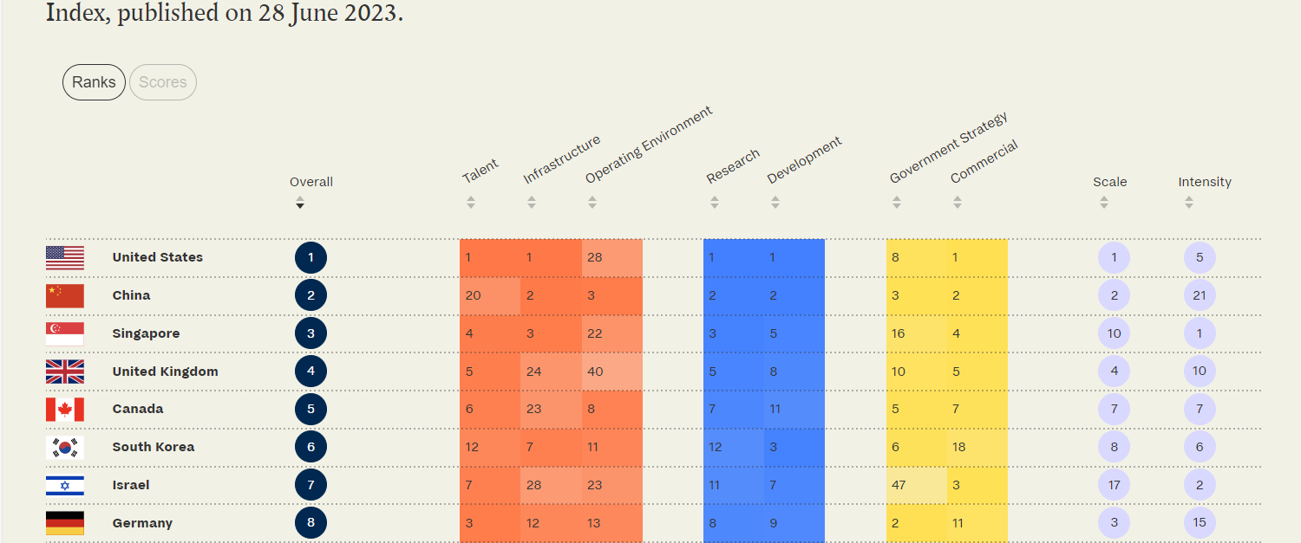
Notes:
Tortoise Media

